Slide 1
HR Attrition Analytics
Strategic Workforce Insights

Slide 2
Work Team
Donya Tawfik
Maher Gamal
Mohammed Abdel Hady
Mustafa Zaky
Rahma Yosry
Shymaa Mohammed
Under the Supervision of
Dr. Maged Magdy

Slide 3
Project Steps
Data Exploration and Problem Statement
Data Preparation & Cleaning
Data Modeling & Star Schema
Power BI Dashboard
Key Insights & Recommendations

Slide 4
Problem Statement
This analysis leverages a five-file HR dataset to identify key drivers of attrition and measure critical HR KPIs. The dataset includes employee demographics, performance ratings, education levels, rating scales, and satisfaction levels.
Problem Statement:
Despite maintaining a stable workforce, the organization is facing a critical attrition rate of 16.1%, which disproportionately affects new joiners (0–2 years) and employees subjected to high overtime. This 'Onboarding Trap' and burnout cycle result in an estimated annual replacement cost of $40.156M, while simultaneously threatening the long-term talent pipeline. Currently, HR interventions are reactive, leading to the loss of high-potential employees who exhibit high performance but low job satisfaction.
The Goal:
To transition from descriptive reporting to a predictive retention strategy that identifies flight risks before they exit, specifically targeting compensation equity and workload balance.

Slide 5
Data Exploration
Upon exploration of the dataset, we found the following:
There are five datasets covering the data of employees and the data of satisfaction and performance. By simple analysis of the data, we reached the following KPIs:
Total Number of Employees = 1470 (Active: 1233 & Exited: 237)
Attrition Rate: 16.12%
Estimated Replacement Cost: 40.156 million dollars
Average Age: 28.99 years
Average Tenure: 4.97 years for active

Slide 6
Key DAX Measures
Total_Employees = COUNT(Employee[EmployeeID])
Attrition_Rate = DIVIDE([Exited_Employees], [Total_Employees], 0)
Average_Tenure_Active = CALCULATE(AVERAGE(Employee[YearsAtCompany]), Employee[Attrition] = "No")
New_Joiner_Attrition = CALCULATE([Attrition_Rate], Employee[YearsAtCompany] <= 2)
Overtime_Percentage = DIVIDE(CALCULATE(COUNT(Employee[EmployeeID]), Employee[OverTime] = "Yes"), COUNT(Employee[EmployeeID]))

Slide 7
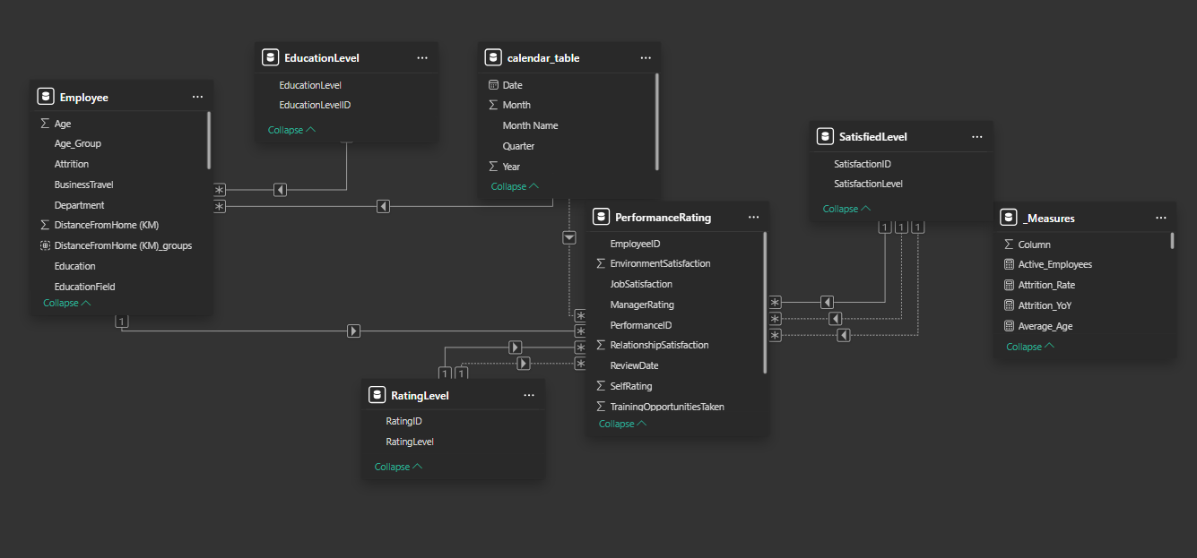
Data Modelling
In this stage, we sought to generate a clear and simple model where all fact tables and dimension tables are correctly connected to each other

Slide 8
Significant KPIs
Attrition Rate: The output of the division of number of leavers by the total number of employees.
Tenure: The period that the employee stays at the company.
Overtime Risk: The output of the division of number of employees who works on overtime basis by the total number of employees.
Job Satisfaction, Environment Satisfaction & Relationship Satisfaction: They are surveyed data scaled from 1 to 5
Job Satisfaction, Environment Satisfaction & Relationship Satisfaction: They are surveyed data scaled from 1 to 5
Manager Rating & Self Rating: They are surveyed data scaled from 1 to 5

Slide 9
Anomalies
Salary Disparity for Attrition of High Performers
While not an anomaly in the sense of data error, the significant disparity between the average salaries of high-performing employees who stay versus those who leave represents a critical business anomaly. It indicates a potential failure in compensation strategies to retain top talent, where employees are leaving despite strong performance, likely due to uncompetitive remuneration. This is an unexpected behavior that warrants immediate investigation.
Low Attrition with High Years Since Last Promotion (10+ years)
Interestingly, employees with 10 or more years since their last promotion show 0% attrition. This is an anomaly when contrasted with the high attrition rates for those with 0-1 years since promotion. This could indicate a segment of highly tenured, stable employees who are less driven by promotional opportunities, or perhaps have reached senior individual contributor roles where promotions are less frequent but job satisfaction remains high.

Slide 10
Business Implications
Talent Drain Risk:
The loss of high-performing employees and those in critical early/mid-career stages (25-35 age group) poses a significant risk to organizational capability, innovation, and future leadership pipelines.
Burnout and Productivity:
High attrition among employees working overtime suggests potential issues with workload distribution, resource allocation, or unrealistic expectations, leading to burnout and reduced overall productivity.
Compensation and Recognition Gaps:
The salary disparity for attrition of high performers implies that the current compensation and recognition framework may not be effectively retaining top talent, leading to a competitive disadvantage.
Employee Experience Erosion:
The subtle downward trend in manager ratings and environment satisfaction points to a gradual deterioration of the overall employee experience, which could impact engagement and retention across the board.

Slide 11
Key Insights
The High Cost of Stagnation ‒ Promotion Lag Drives Early Attrition
Employees who have not received a promotion in the last year exhibit a significantly higher attrition rate (37.87%) compared to those promoted more recently. This rate drops sharply to 24.64% for those promoted one year ago and further declines to 10% for those promoted two years ago. This suggests that the initial period post-promotion, or lack thereof, is critical for retention. The perceived lack of career progression early on acts as a strong catalyst for employees to seek opportunities elsewhere.
Overtime as a Predictor of Attrition, Not Just a Symptom
Employees consistently working overtime have an attrition rate of 30.53%, nearly three times higher than those who do not work overtime (10.44%). This is a non-obvious insight because overtime is often seen as a sign of dedication or peak demand. However, this data suggests that sustained overtime leads to burnout and dissatisfaction, making these employees significantly more likely to leave. This indicates a potential systemic issue with workload management or staffing levels in certain areas.

Slide 12
Key Insights
The Paradox of High Performers and Attrition
While overall attrition is 16.12%, high performers (those with a Manager Rating of 4 or 5) still show a notable attrition rate of approximately 19.13%. More critically, the average salary for high performers who attrite is significantly lower than that of high performers who stay. This suggests that the organization is losing its top talent, particularly when their compensation does not align with their performance, indicating a potential pay equity or recognition gap for high achievers.
The 'Mid-Career' Attrition Trap
The attrition rate is highest among employees in the 25-35 age group (19.52%), followed closely by those under 25 (18.00%). This is a critical period for career development and personal growth. Employees in these age brackets are often seeking rapid advancement, skill development, and competitive compensation. If these expectations are not met, they are more prone to attrition, representing a significant loss of developing talent and institutional knowledge.

Slide 13
Key Insights
Sales Representative and Recruiter are effectively revolving-door roles
At ~39% and ~37.5% attrition respectively, almost 1 in 3 employees in these roles leaves every cycle. The irony is that Recruiters — the people responsible for filling talent gaps — face the highest structural risk, likely because they see exactly how undervalued their role is compared to others.
The Performance Review System has a structural flaw
In 6,709 reviews, not a single case exists where a manager rated an employee higher than the employee's self-rating. This isn't a behavioral quirk — it's a systemic pattern that undermines the credibility of the review process for calibration, pay decisions, and promotions.

Slide 14
Recommendations
Implement a Proactive Promotion and Career Development Program:
Focus on employees with 0-1 years since their last promotion, especially those in the 25-35 age group. This could involve mentorship programs, clear career pathing, and regular check-ins to discuss growth opportunities. Consider a “promotion readiness” assessment to identify and fast-track deserving individuals.
Optimize Workload and Overtime Management:
Investigate departments and roles with high overtime rates. This may require re-evaluating staffing levels, improving process efficiencies, or implementing stricter policies around mandatory overtime to prevent burnout and reduce attrition.
Review Compensation and Recognition for High Performers:
Conduct a comprehensive review of salary bands and bonus structures for high-performing employees. Ensure that compensation is competitive and aligned with market rates and individual contributions to retain top talent. Implement non-monetary recognition programs to boost morale and loyalty.

Slide 15
Recommendations
Enhance Employee Experience and Engagement:
Address the subtle decline in environment satisfaction and manager ratings. This could involve conducting targeted pulse surveys, improving workplace facilities, fostering a more positive work culture, and providing training for managers on effective feedback and support.
Deep Dive into Long-Tenured, Non-Promoted Employees:
Investigate the motivations and satisfaction drivers of employees with 10+ years since their last promotion who exhibit low attrition. Understanding this segment can provide valuable insights into alternative retention strategies beyond traditional promotions.

Slide 16
Thank You

